Slide 1
Module 3 Examples
TAs: Nihal Reddy
Email: nireddy@ucsd.edu
OH: Thursdays 6-7pm Slide Credits: Kira Fleischer

Slide 2
Problem #: Key topics from problem
Problem setup and description.
Question
Key notes from readings/lectures needed to answer the question
Solution: written with as much detail as we expect you to give on your homework sets

Slide 3
Problem 1: sample spaces
For this problem, consider a standard deck of 52 cards. (A deck of 52 cards has 4 suits: diamonds, hearts, spades, and clubs. There are 13 cards in each suit: Ace, Two–Ten, Jack, Queen, King.) What is the sample space associated with:
(a) drawing two cards and recording their sum (assume Ace has a value of 1, and Jack, Queen, King all have a value of 10)
Sample Space: The set of all possible outcomes associated with the event
Solution: {2, 3, 4, 5, 6, 7, 8, 9, 10, 11, 12, 13, 14, 15, 16, 17, 18, 19, 20}
(b) the number of cards with the suit spades when drawing five cards
Solution: {0, 1, 2, 3, 4, 5}

Slide 4
Problem 2: independent events
Suppose that a fair 6-sided die is rolled. The probability space is S = {1, 2, 3, 4, 5, 6}. We then define the following events:
A : The number rolled is odd.
B : The number rolled is greater than or equal to 4.
C : The number rolled doesn’t start with the letters “f” or “t”.
(a) Determine the events A, B, C in terms of a set.
Solution: A : {1, 3, 5}; B : {4, 5, 6}; C : {1, 6}.

Slide 5
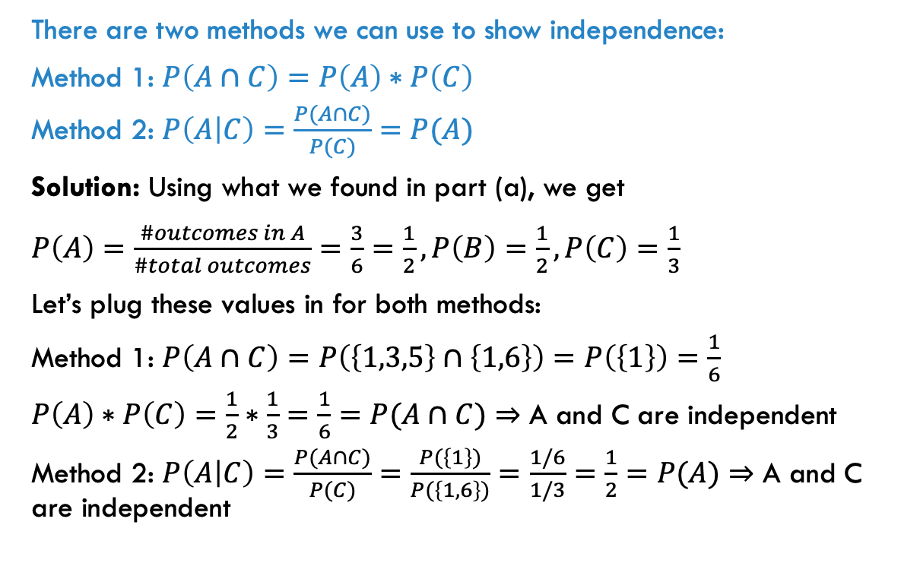
Problem 2: independent events
Suppose that a fair 6-sided die is rolled. The probability space is S = {1, 2, 3, 4, 5, 6}. We then define the following events:
A : The number rolled is odd.
B : The number rolled is greater than or equal to 4.
C : The number rolled doesn’t start with the letters “f” or “t”.
(b) Decide whether A and C are independent.
There are two methods we can use to show independence:
Method 1: $P\left(A∩C\right)=P\left(A\right)∗P\left(C\right)$
Method 2: $P\left(A | C\right)=\frac{P(A∩C)}{P(C)}=P(A)$
Solution: Using what we found in part (a), we get
$P\left(A\right)=\frac{\#outcomes in A}{\#total outcomes}=\frac{3}{6}=\frac{1}{2}, P\left(B\right)=\frac{1}{2}, P\left(C\right)=\frac{1}{3}$
Let’s plug these values in for both methods:
Method 1: $P\left(A∩C\right)=P\left(\left\{1,3,5\right\}∩\left\{1,6\right\}\right)=P\left(\left\{1\right\}\right)=\frac{1}{6}$
$P\left(A\right)∗P\left(C\right)=\frac{1}{2}∗\frac{1}{3}=\frac{1}{6}=P(A∩C)⇒$ A and C are independent
Method 2: $P\left(A | C\right)=\frac{P(A∩C)}{P(C)}=\frac{P(\left\{1\right\})}{P(\left\{1,6\right\})}=\frac{1/6}{1/3}=\frac{1}{2}=P(A)$ $⇒$ A and C are independent

Slide 6
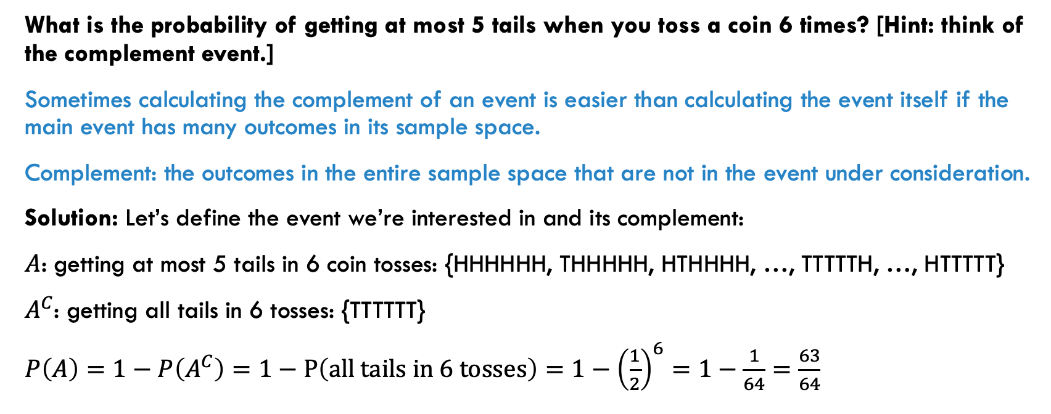
Problem 3: using complements to find probabilities of interest
What is the probability of getting at most 5 tails when you toss a coin 6 times? [Hint: think of the complement event.]
Sometimes calculating the complement of an event is easier than calculating the event itself if the main event has many outcomes in its sample space.
Complement: the outcomes in the entire sample space that are not in the event under consideration.
Solution: Let’s define the event we’re interested in and its complement:
$A$: getting at most 5 tails in 6 coin tosses: {HHHHHH, THHHHH, HTHHHH, …, TTTTTH, …, HTTTTT}
$A^{C}$: getting all tails in 6 tosses: {TTTTTT}
$P\left(A\right)=1−P\left(A^{C}\right)=1−P\left(all tails in 6 tosses\right)=1−{\left(\frac{1}{2}\right)}^{6}=1−\frac{1}{64}=\frac{63}{64}$

Slide 7
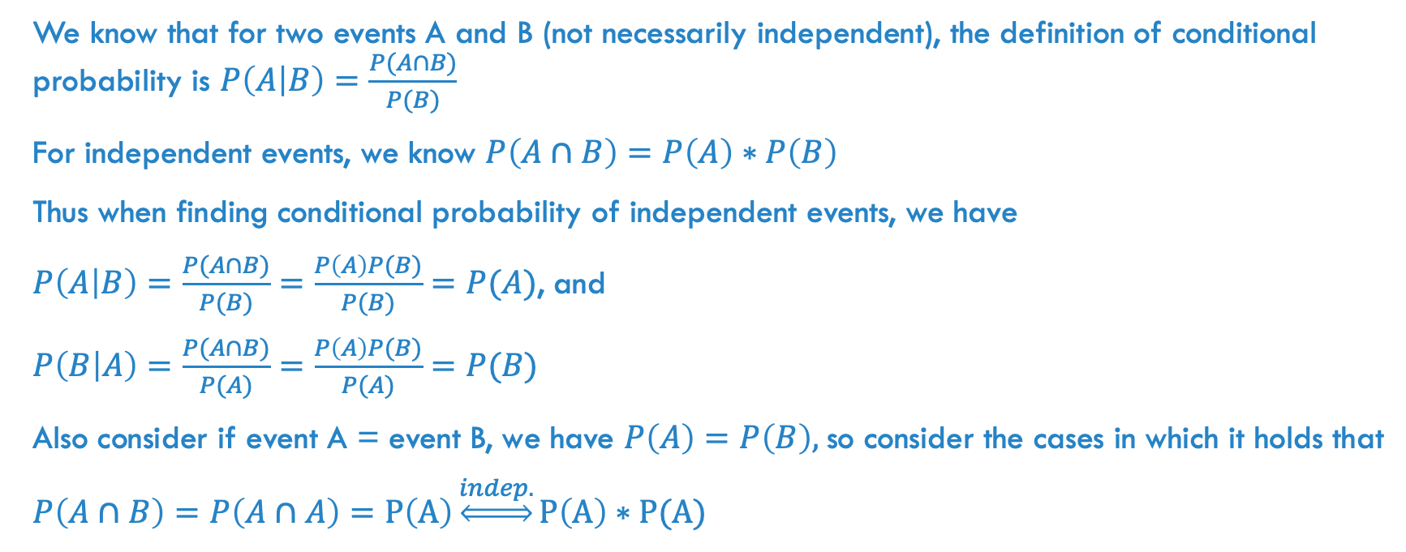
Problem 4: independence and conditional probability
We know that for two events A and B (not necessarily independent), the definition of conditional probability is $P\left(A | B\right)=\frac{P(A∩B)}{P(B)}$
For independent events, we know $P\left(A∩B\right)=P\left(A\right)∗P\left(B\right)$
Thus when finding conditional probability of independent events, we have
$P\left(A | B\right)=\frac{P(A∩B)}{P(B)}=\frac{P\left(A\right)P(B)}{P(B)}=P(A)$, and
$P\left(B | A\right)=\frac{P(A∩B)}{P(A)}=\frac{P\left(A\right)P(B)}{P(A)}=P(B)$
Also consider if event A = event B, we have $P\left(A\right)=P\left(B\right),$so consider the cases in which it holds that
$P\left(A∩B\right)=P\left(A∩A\right)=P\left(A\right)\underset{⇔}{indep.}P\left(A\right)∗P(A)$

Slide 8
Problem 5: probabilities from a population
According to the Stanford School of Medicine Blood Center, 44% of Americans have type O blood, 42% have type A blood, 10% have type B blood, and the rest are of type AB.
(a) If you were to chose one random American, what is the probability that their blood type is not A?
Solution: P(one American is not of blood type A) = 1 – P(one American IS of blood type A) = 1 – 0.42 = 0.58.

Slide 9
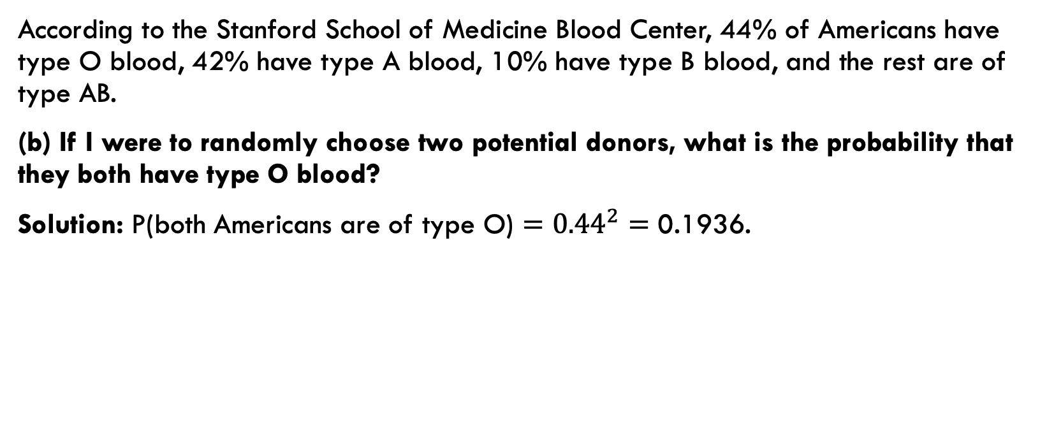
Problem 5: probabilities from a population
According to the Stanford School of Medicine Blood Center, 44% of Americans have type O blood, 42% have type A blood, 10% have type B blood, and the rest are of type AB.
(b) If I were to randomly choose two potential donors, what is the probability that they both have type O blood?
Solution: P(both Americans are of type O) $={0.44}^{2}=\text{0.1936}$.

Slide 10
Problem 5: probabilities from a population
According to the Stanford School of Medicine Blood Center, 44% of Americans have type O blood, 42% have type A blood, 10% have type B blood, and the rest are of type AB.
(c) What is the probability that one randomly chosen American is of blood type A or AB?
Solution: P(one American has blood type A or AB)
= P(they have type A) + P(they have type AB)
= 0.42 + [1 – (0.44 + 0.42 + 0.10)]
= 0.42 + 0.04 = 0.46

Slide 11
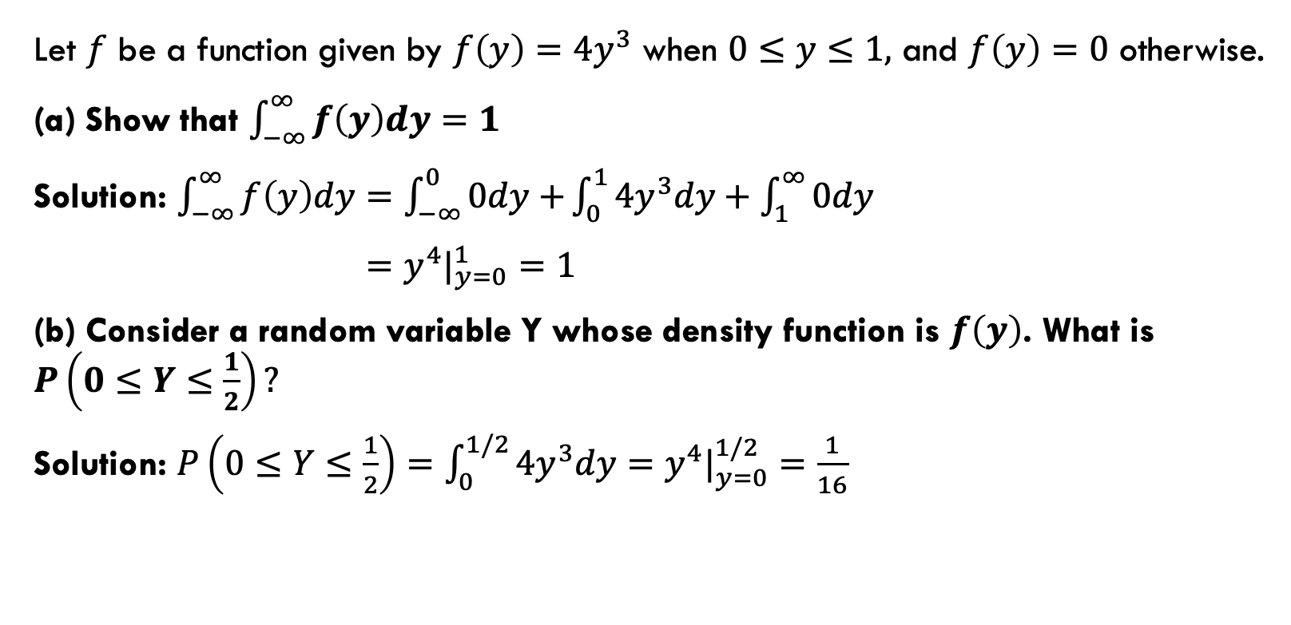
Problem 6: probability density functions for continuous random variables
Let $f$ be a function given by $f\left(y\right)=4y^{3}$ when $0≤y≤1,$ and $f\left(y\right)=0$ otherwise.
(a) Show that $\int_{−∞}^{∞}{f\left(y\right)dy}=1$
Solution: $\int_{−∞}^{∞}{f\left(y\right)dy}=\int_{−∞}^{0}{0dy+}\int_{0}^{1}{4y^{3}dy+\int_{1}^{∞}{0dy}}$
$=y^{4}|_{y=0}^{1}=1$
(b) Consider a random variable Y whose density function is $f\left(y\right)$. What is $P\left(0≤Y≤\frac{1}{2}\right)?$
Solution: $P\left(0≤Y≤\frac{1}{2}\right)=\int_{0}^{1/2}{4y^{3}dy=}$ $y^{4}|_{y=0}^{1/2}=\frac{1}{16}$

Slide 12
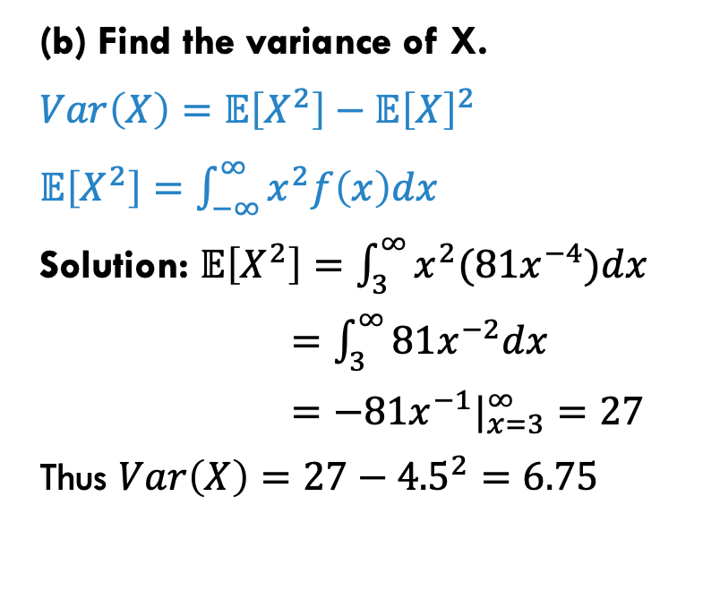
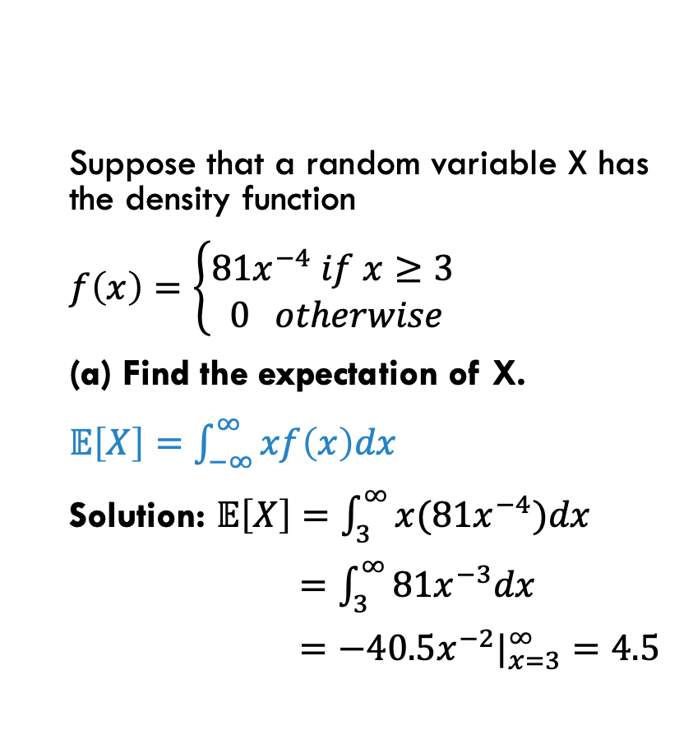
Problem 7: expectation and variance of continuous random variables
Suppose that a random variable X has the density function
$f\left(x\right)=\left\{\begin{aligned}81x^{−4} if x≥3 \\ 0 otherwise\end{aligned}\right.$
(a) Find the expectation of X.
$𝔼\left[X\right]=\int_{−∞}^{∞}{xf\left(x\right)dx}$
Solution: $𝔼\left[X\right]=\int_{3}^{∞}{x(81x^{−4})dx}$
$=\int_{3}^{∞}{81x^{−3}dx}$
$=−40.5x^{−2}|_{x=3}^{∞}=4.5$
(b) Find the variance of X.
$Var\left(X\right)=𝔼\left[X^{2}\right]−{𝔼\left[X\right]}^{2}$
$𝔼\left[X^{2}\right]=\int_{−∞}^{∞}{x^{2}f\left(x\right)dx}$
Solution: $𝔼\left[X^{2}\right]=\int_{3}^{∞}{x^{2}(81x^{−4})dx}$
$=\int_{3}^{∞}{81x^{−2}dx}$
$=−81x^{−1}|_{x=3}^{∞}=27$
Thus $Var\left(X\right)=27−{4.5}^{2}=6.75$

Slide 13
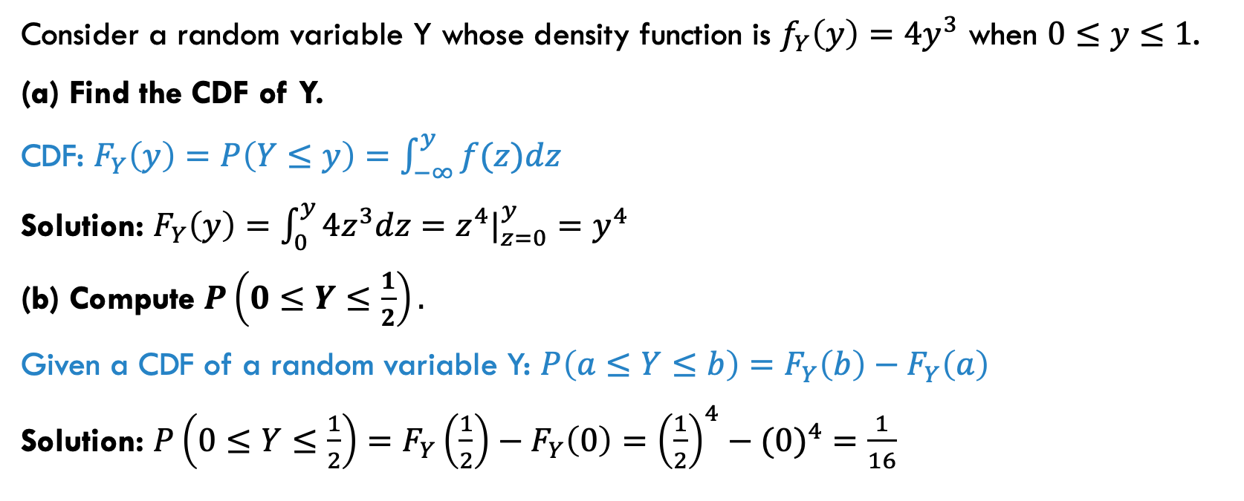
Problem 8: cumulative density functions
Consider a random variable Y whose density function is $f_{Y}\left(y\right)=4y^{3}$ when $0≤y≤1$.
(a) Find the CDF of Y.
CDF: $F_{Y}\left(y\right)=P\left(Y≤y\right)=\int_{−∞}^{y}{f(z)dz}$
Solution: $F_{Y}\left(y\right)=\int_{0}^{y}{4z^{3}dz}=z^{4}|_{z=0}^{y}=y^{4}$
(b) Compute $P\left(0≤Y≤\frac{1}{2}\right).$
Given a CDF of a random variable Y: $P\left(a≤Y≤b\right)=F_{Y}\left(b\right)−F_{Y}\left(a\right)$
Solution: $P\left(0≤Y≤\frac{1}{2}\right)=F_{Y}\left(\frac{1}{2}\right)−F_{Y}\left(0\right)={\left(\frac{1}{2}\right)}^{4}−({0)}^{4}=\frac{1}{16}$

Slide 14
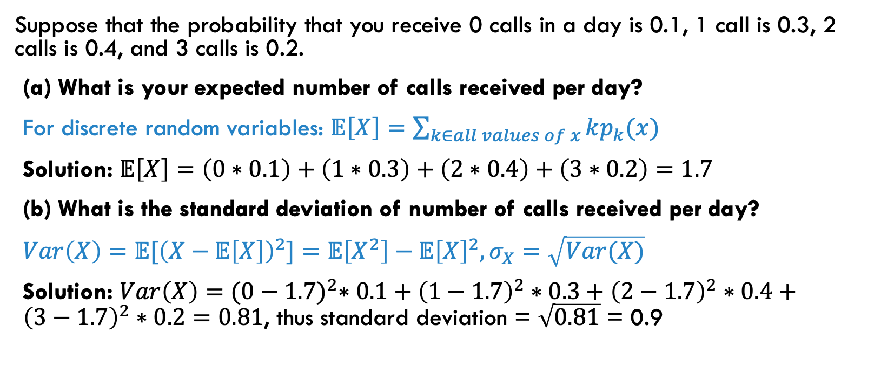
Problem 9: expectation for discrete random variables
Suppose that the probability that you receive 0 calls in a day is 0.1, 1 call is 0.3, 2 calls is 0.4, and 3 calls is 0.2.
(a) What is your expected number of calls received per day?
For discrete random variables: $𝔼\left[X\right]=\sum_{k∈all values of x}{kp_{k}(x)}$
Solution: $𝔼\left[X\right]=\left(0∗0.1\right)+\left(1∗0.3\right)+\left(2∗0.4\right)+\left(3∗0.2\right)=1.7$
(b) What is the standard deviation of number of calls received per day?
$Var\left(X\right)={𝔼[\left(X−𝔼\left[X\right]\right)}^{2}]=𝔼\left[X^{2}\right]−{𝔼\left[X\right]}^{2}, σ_{X}=\sqrt{Var(X)}$
Solution: $Var\left(X\right)={(0−1.7)}^{2}∗0.1+{\left(1−1.7\right)}^{2}∗0.3+{\left(2−1.7\right)}^{2}∗0.4+{\left(3−1.7\right)}^{2}∗0.2=0.81$, thus standard deviation = $\sqrt{0.81}$ = 0.9

Slide 15
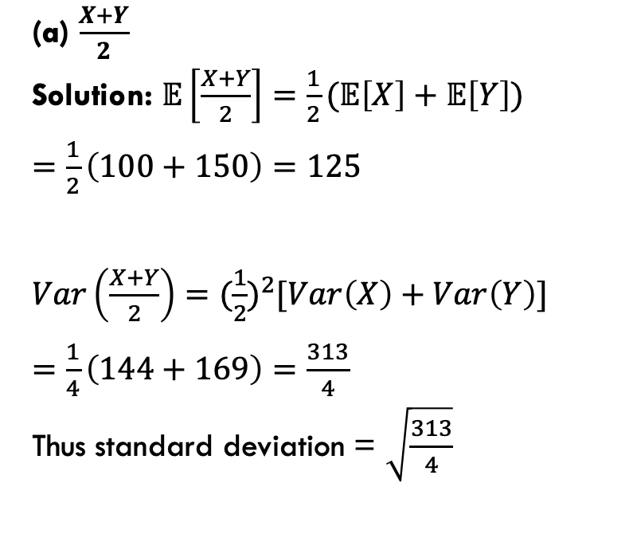
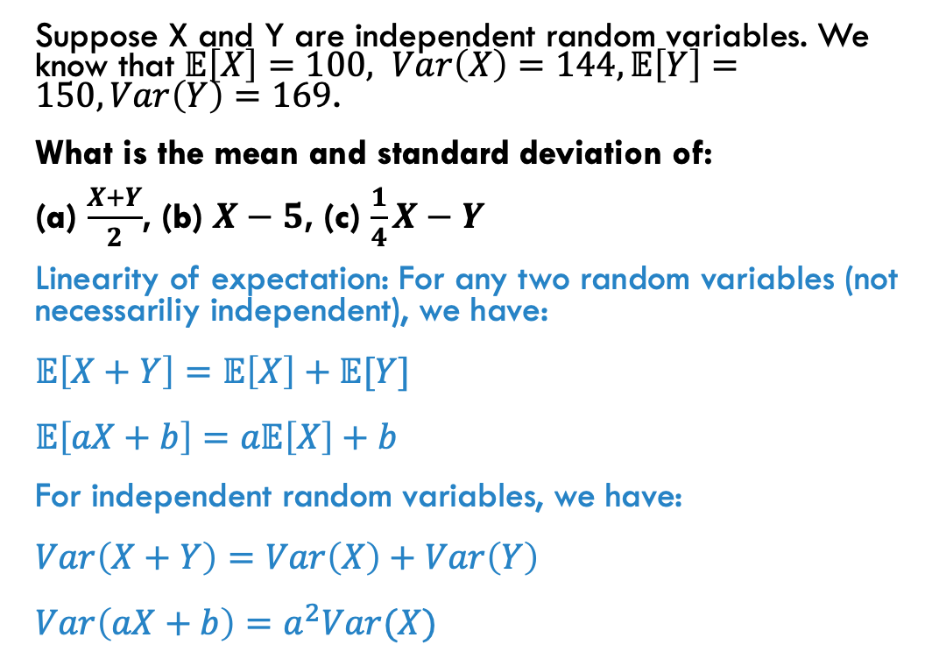
Problem 10: linearity of expectation, independent random variables
Suppose X and Y are independent random variables. We know that $𝔼\left[X\right]=100, Var\left(X\right)=144,𝔼\left[Y\right]=150, Var\left(Y\right)=169$.
What is the mean and standard deviation of:
(a) $\frac{X+Y}{2}$, (b) $X−5$, (c) $\frac{1}{4}X−Y$
Linearity of expectation: For any two random variables (not necessariliy independent), we have:
$𝔼\left[X+Y\right]=𝔼\left[X\right]+𝔼[Y]$
$𝔼\left[aX+b\right]=a𝔼\left[X\right]+b$
For independent random variables, we have:
$Var\left(X+Y\right)=Var\left(X\right)+Var\left(Y\right)$
$Var\left(aX+b\right)=a^{2}Var(X)$
(a) $\frac{X+Y}{2}$
Solution: $𝔼\left[\frac{X+Y}{2}\right]=\frac{1}{2}(𝔼\left[X\right]+𝔼\left[Y\right])$
$=\frac{1}{2}\left(100+150\right)=125$
$Var\left(\frac{X+Y}{2}\right)=({\frac{1}{2})}^{2}[Var\left(X\right)+Var\left(Y\right)]$
$=\frac{1}{4}\left(144+169\right)=\frac{313}{4}$
Thus standard deviation = $\sqrt{\frac{313}{4}}$

Slide 16
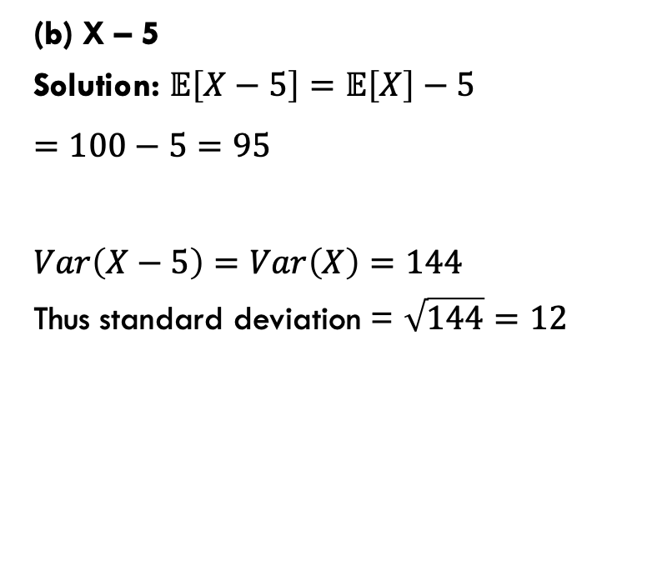
Problem 10: linearity of expectation, independent random variables
Suppose X and Y are independent random variables. We know that $𝔼\left[X\right]=100, Var\left(X\right)=144,𝔼\left[Y\right]=150, Var\left(Y\right)=169$.
What is the mean and standard deviation of:
(a) $\frac{X+Y}{2}$, (b) $X−5$, (c) $\frac{1}{4}X−Y$
Linearity of expectation: For any two random variables (not necessariliy independent), we have:
$𝔼\left[X+Y\right]=𝔼\left[X\right]+𝔼[Y]$
$𝔼\left[aX+b\right]=a𝔼\left[X\right]+b$
For independent random variables, we have:
$Var\left(X+Y\right)=Var\left(X\right)+Var\left(Y\right)$
$Var\left(aX+b\right)=a^{2}Var(X)$
(b) X – 5
Solution: $𝔼\left[X−5\right]=𝔼\left[X\right]−5$
$=100−5=95$
$Var\left(X−5\right)=Var\left(X\right)=144$
Thus standard deviation = $\sqrt{144}=12$

Slide 17
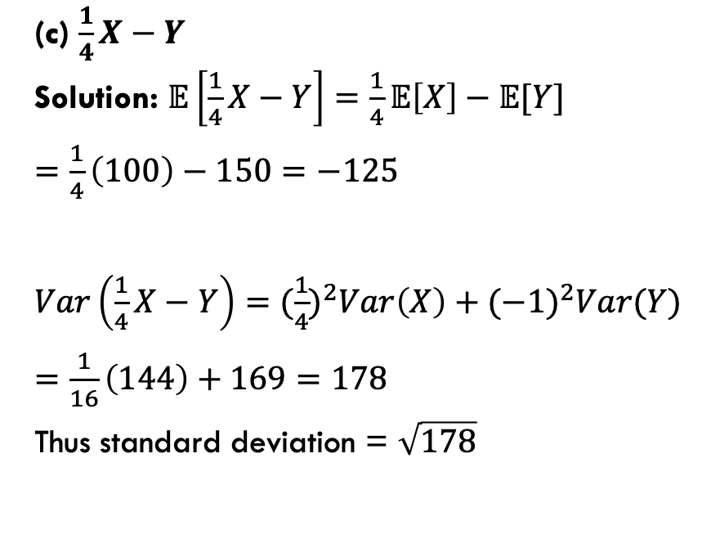
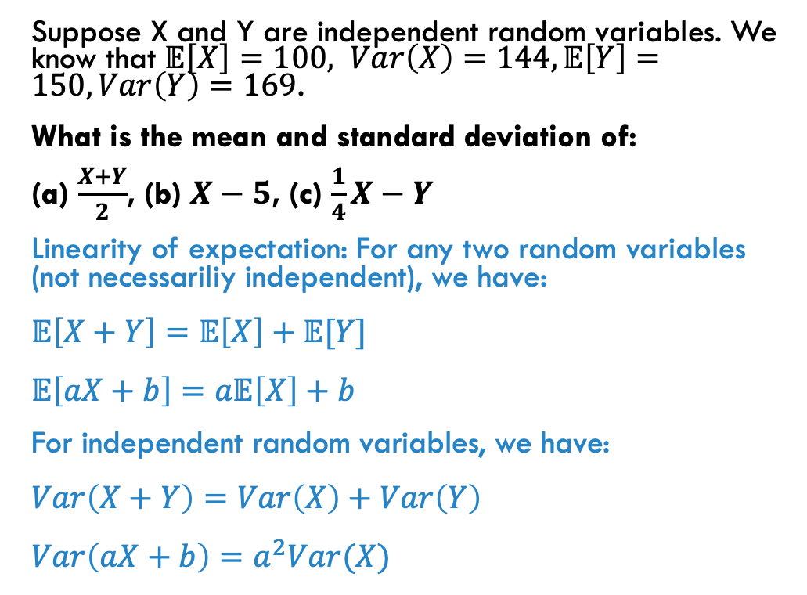
Problem 10: linearity of expectation, independent random variables
Suppose X and Y are independent random variables. We know that $𝔼\left[X\right]=100, Var\left(X\right)=144,𝔼\left[Y\right]=150, Var\left(Y\right)=169$.
What is the mean and standard deviation of:
(a) $\frac{X+Y}{2}$, (b) $X−5$, (c) $\frac{1}{4}X−Y$
Linearity of expectation: For any two random variables (not necessariliy independent), we have:
$𝔼\left[X+Y\right]=𝔼\left[X\right]+𝔼[Y]$
$𝔼\left[aX+b\right]=a𝔼\left[X\right]+b$
For independent random variables, we have:
$Var\left(X+Y\right)=Var\left(X\right)+Var\left(Y\right)$
$Var\left(aX+b\right)=a^{2}Var(X)$
(c) $\frac{1}{4}X−Y$
Solution: $𝔼\left[\frac{1}{4}X−Y\right]=\frac{1}{4}𝔼\left[X\right]−𝔼[Y]$
$=\frac{1}{4}\left(100\right)−150=−125$
$Var\left(\frac{1}{4}X−Y\right)={(\frac{1}{4})}^{2}Var\left(X\right)+({−1)}^{2}Var(Y)$
$=\frac{1}{16}\left(144\right)+169=178$
Thus standard deviation = $\sqrt{178}$

